Slide 1
Field Observation

Slide 2
Package Form Factor and Packaging
Need early package FF roadmap/changes update - customer capital cost impact
  FF changed significantly in short period, from Purely (2017 PRQ) → Eagle Stream (PRQ EO 2021) → Birch Stream-AP (PRQ EO 2022)
Au pad corrosion – multiple triggers, multiple products, multiple customers, multiple MRBs for ~ 10 years and fixes still WIP
  XEON SP unit selling price between from USD 200 (Bronze) – 10K (Platinum). The product deserved seal pack to stop “external” air pollutants interacting with pad condition/crevice that coherent in the package technology/assembly process.
Provide pack/shipping options : e.g. Ship with Thermoform Tray (TFT), JEDEC tray or Tape & Reel (PCH), or CPU w/carrier pre-attached
  Some customers had been manually transferred PCH from T&R to trays and TFT to hard trays for their mfg process.
Fix marking KIZ, content, FOV, location, optimum font size and ensure documentation in CRD – customer unit traceability and inventory mgmt/control

Slide 3
Socket PCBA / Rework
Customer expects 1 SMT recipe to assemble socket for all suppliers and SPC controls.
  Need socket supplier transparency for SMT, equivalent output CTF and shipping tray (e.g. quality control/SPC, # socket/tray, orientation & etc)
    Socket tray CTF pilot in socket P4 and P5. Continue to keep proliferate.
  Recent supplier excursion : FIT skt-P4 T0 DP, LOTES skt-P0 sys int failure, FIT skt-P4 Bolster out of spec, FIT skt-V0 lever height and load plate angle issue
    some data showed process drifted, beyond LCL/UCL established during DG1.0
RT and HT warpage requirement/control concerns for socket and PCB
  Rumors of competitor product (SP5) to be launched with Low Temperature Solder (LTS) and another competitor with Thermal Chip Bonding for PCB assembly
  Also, there are customers looking forward for feasibility of LTS and/or Thermal Chip Bonding in Intel Server products

Slide 4
LM, Socket cover, PnP tool, FTT
Customer expects – automation friendly, easy to install, easy to uninstall (易装，易拆)
FTT – POR for Purely but Non- POR for skt-P4/skt-E and broken PEEK nuts issue
  Strong demand from varies customers due to their dual POR process (automated test fixture for 2S and manual test for 4S/8S, test fixture cost approx. USD40K).
  Broken PEEK nuts due to torque driver hitting PEEK nuts and/or torque with an angle
  FTT/system assembly tool is being developed (non-POR support) to address customer concerns – need to include as POR for future platform for automation
Socket cover – customer expects automation friendly and easy to install/ uninstall.
Other CPU PnP / PHLM / ILM / carrier concept

Slide 5
Back Up

Slide 6
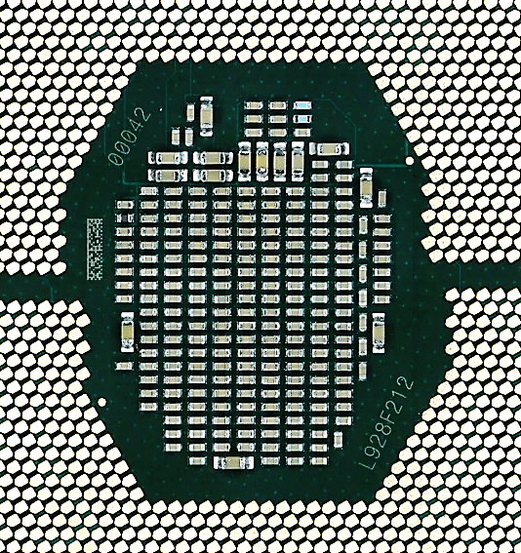
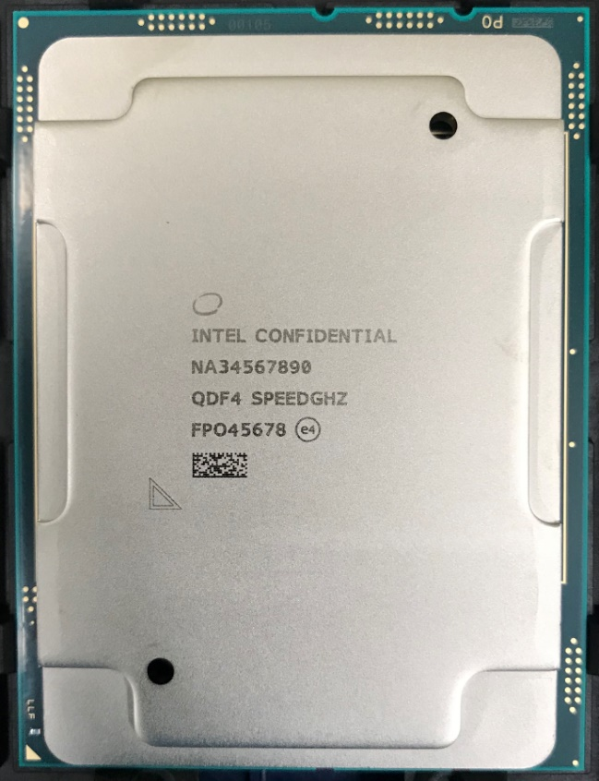
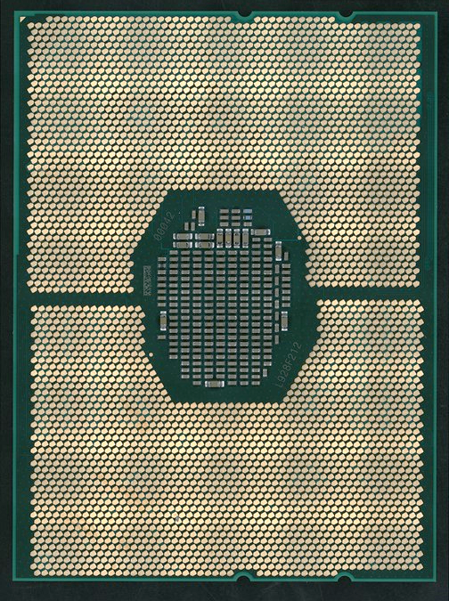
Purley Processor (Cascade Lake)
SN (00042)
Example of Marking on Package Top Side
Pin 1
Example of Marking on Package Bottom Side
Standard 2DID Matrix for traceability (random numbers)
2DID Matrix
FPO + SN
(L928F21200042)
FPO (L928F212)
(Traceability purpose -- content is different to top side 2DIDs)
L (1st col) | Factory Code
9 (2nd col) | 2019 - Year of manufactured date
28 (3rd – 4th col) | Intel ww of manufactured date
2DID Matrix (PPIN + SSPEC)
Dimensions: 2.4mm x5.2mm – alternate traceability
Pin 1
FPO = Finish Processing Order
Notes:
EGS – FPO marking is removed due to limited space.

Slide 7
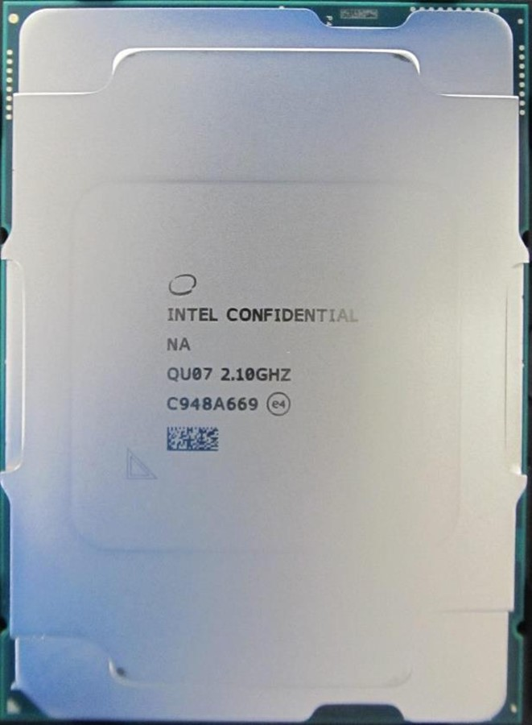
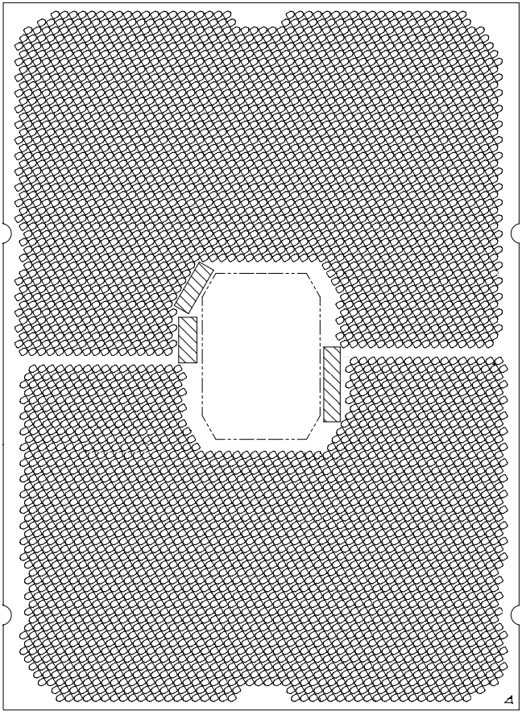
Whitley/Cedar Island Processor (Ice Lake & Cooper Lake)
Example of Marking on Package Top Side
Example of Marking on Package Bottom Side
Top side Marking
Line | Marking
GRP1LINE1 (on IHS) | Intel Swirl
GRP1LINE2 (on IHS) | INTEL CONFIDENTIAL {Intel Brand and Brand Modifier}
GRP1LINE3 (on IHS) | N/A {SKU level/Naming}
GRP1LINE4 (on IHS) | SPEC SPEED
GRP1LINE5 (on IHS) | FPO eX
GRP1LINE6 (on IHS) | 2D Mark {PPIN+SPEC}
GRP1LINE8 (on IHS) | Pin1 Mark on Lid
2D Mark/ VID (on substrate) | Random number (normally used for FACR)
Serial Number
(SN)
2DID
FPO
Bottom side Marking
2DID (2D Matrix) | FPO+ SN (Random number)
Pin 1 Mark

Slide 8
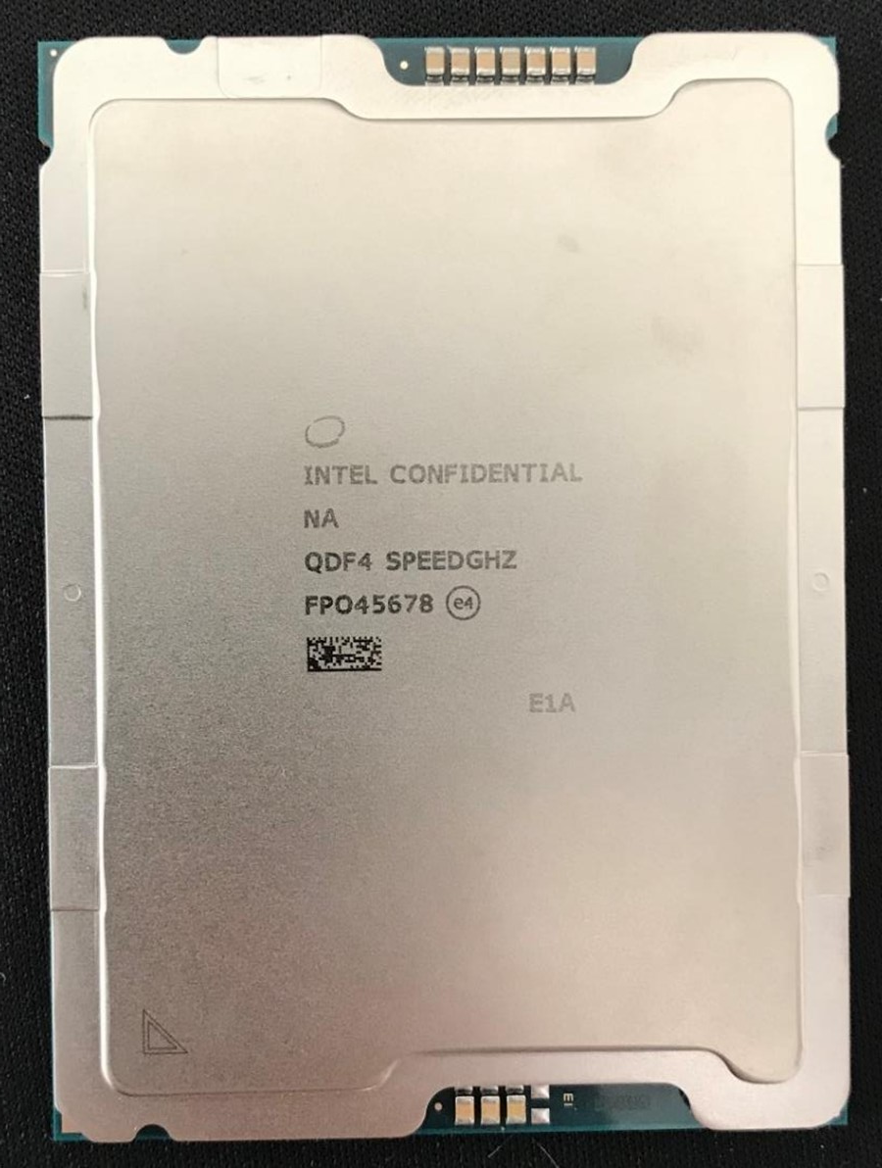
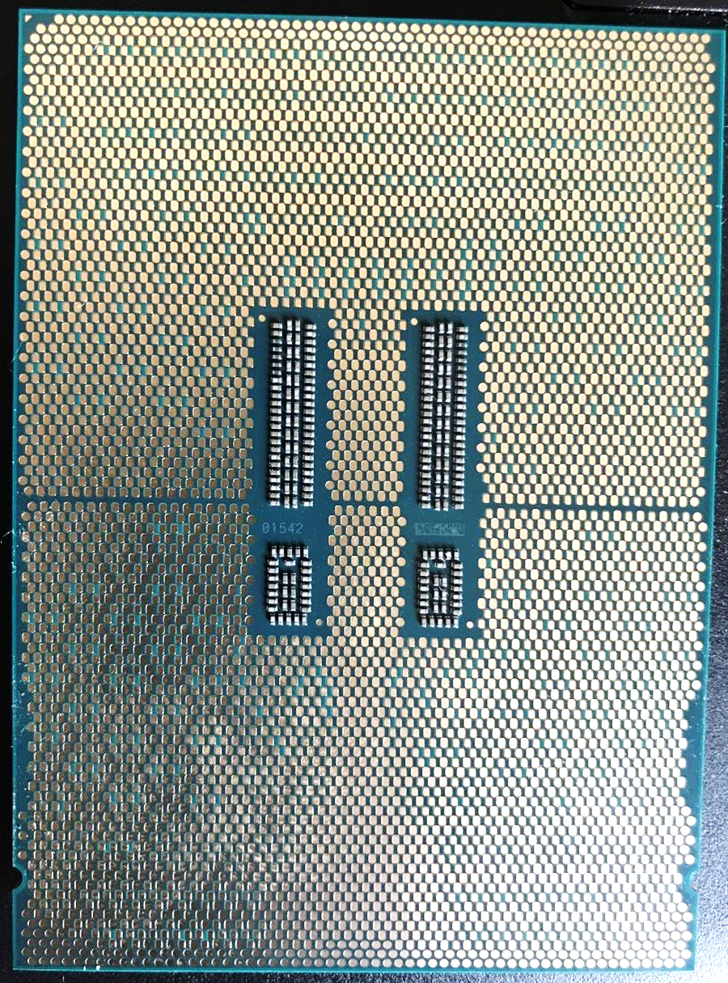
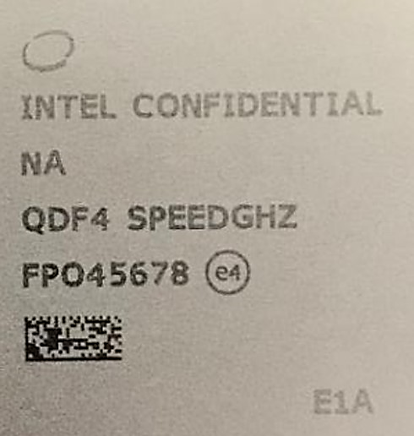
Sapphire Rapids Processor Marking and Identification
Pin 1 Mark
Many customers had implemented bottom 2DID as traceability and inventory control (FPO contained Datecode information)
Need to ensure to keep for future package designs and document in CRD
Top side Marking
Line | Marking
GRP1LINE1 (on IHS) | Intel Swirl
GRP1LINE2 (on IHS) | INTEL CONFIDENTIAL {Intel Brand and Brand Modifier}
GRP1LINE3 (on IHS) | N/A {SKU level/Naming}
GRP1LINE4 (on IHS) | QDF4 {SPEC}
GRP1LINE5 (on IHS) | {FPO} {eX}
GRP1LINE6 (on IHS) | 2D Mark {PPIN+SPEC}
GRP1LINE7 (on IHS) | Package Carrier Mark (PCM)
GRP1LINE8 (on IHS) | Pin1 Mark on Lid
2D Mark/ VID (on substrate) | Random number (normally used for FACR)
Bottom side Marking
2DID (2D Matrix) | FPO+ Random number
Pin 1 Mark
L (1st col) | Factory Code
9 (2nd col) | 2019 - Year of manufactured date
28 (3rd – 4th col) | Intel ww of manufactured date
PCM
PCM
SN – no good meaning to keep once the FPO human readable marking is removed.
VID
FPO = Finish Processing Order
2DID (Must Keep)

Slide 9
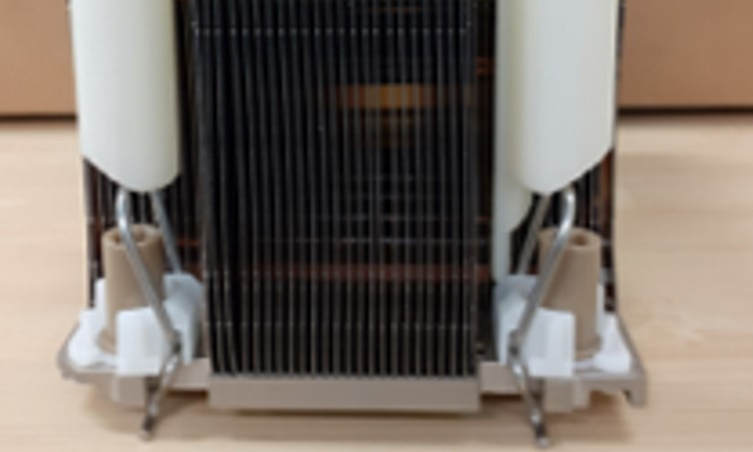
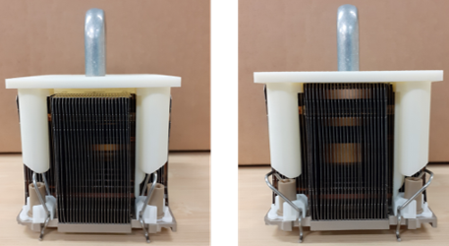
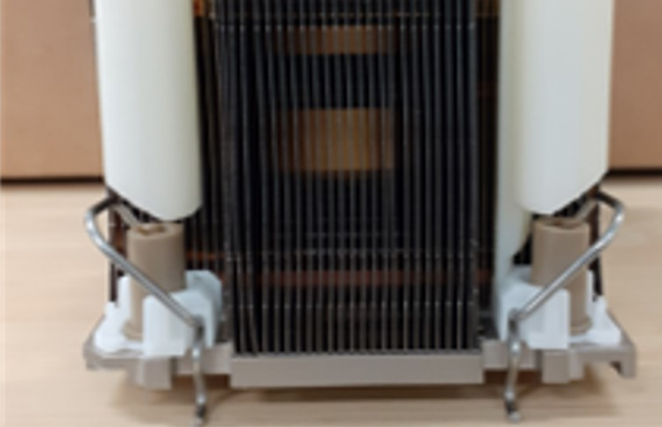
FTT / Sys Assm Tool
(Manual)
1-push to lock anti-tilt wires at 1-time
Guide torque driver bit, prevent bit hitting PEEK nuts and/or nuts tightening with angle.
Need nuts sequencing

Slide 10
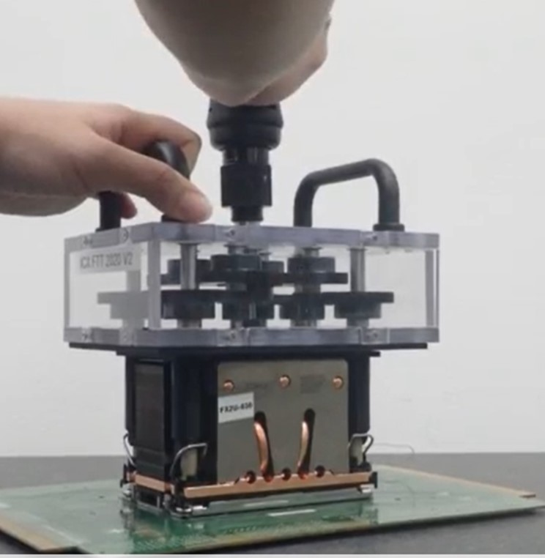
FTT / Sys Assm Tool
(Auto)
1-push to lock anti-tilt wires at 1-time
Guide torque driver bit, prevent bit hitting PEEK nuts and/or nuts tightening with angle.
4 nuts tighten at single torque.

Slide 11
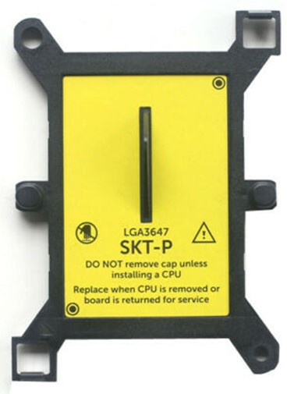
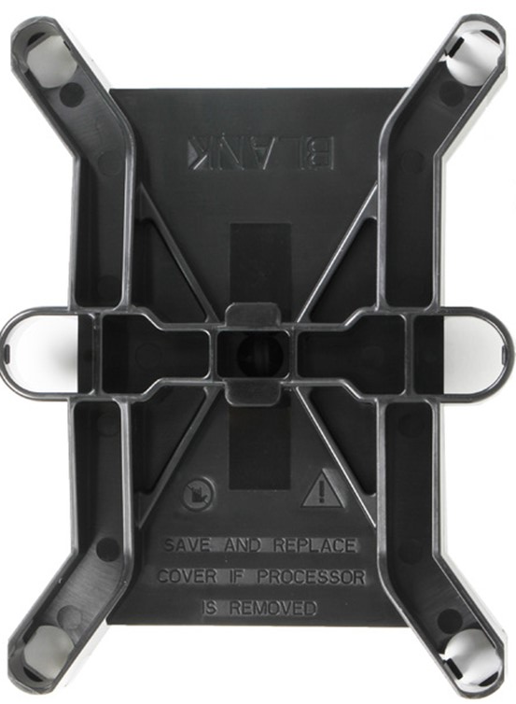
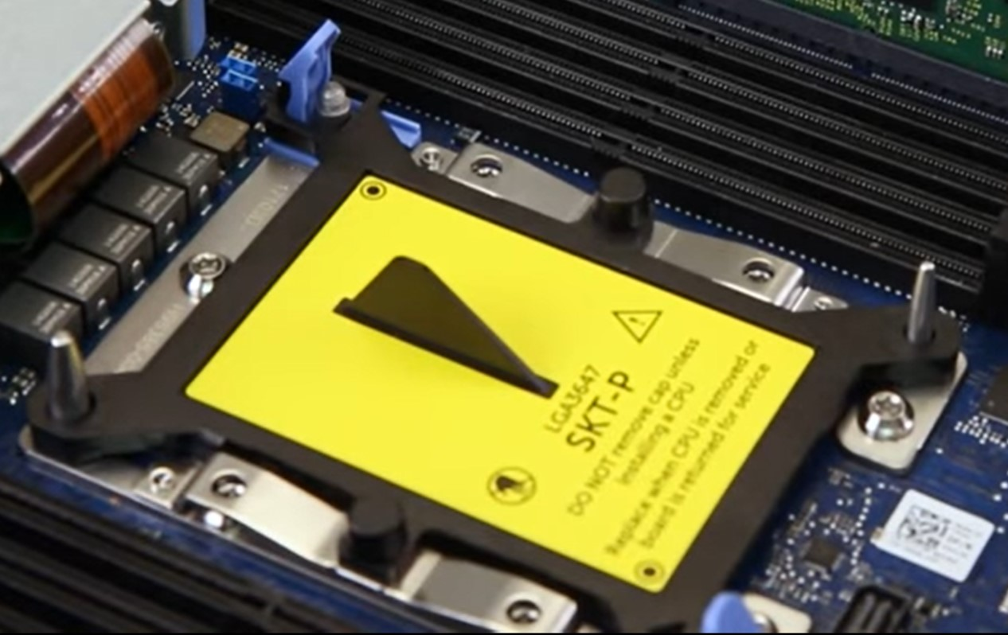
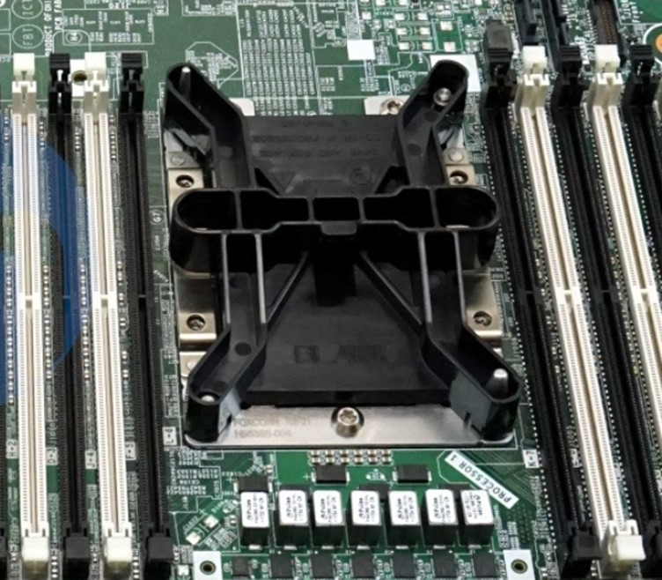
Dust Cover, easy to install, easy to uninstall (易装，易拆 – no ergo spec concerns）
Retention clips
DELL socket cover
(Available on eBay)
- works together with retention clips on bolster
HPE socket cover
(FOXCONN had similar concept)
protection for metal debris ?
Notes:
https://www.youtube.com/watch?v=a7spFUjNTek
https://www.youtube.com/watch?v=alXFJ-p_nNw

Slide 12
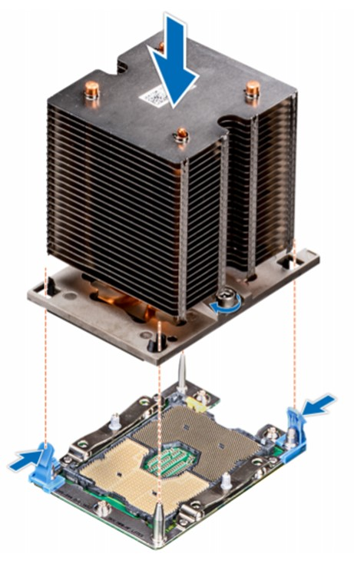
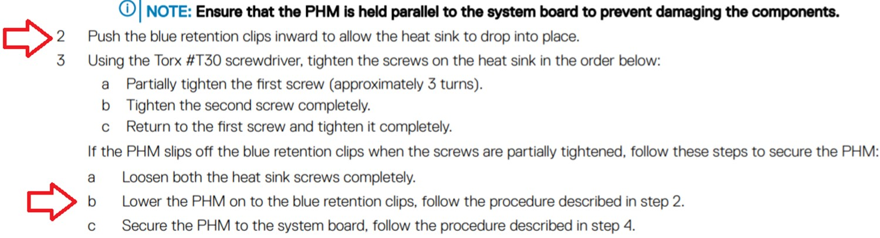
Retention clips act as Anti tilt, lock/unlock PHM
https://cdn.cnetcontent.com/a1/49/a149014d-d35a-444f-8752-2dc0898e107f.pdf

Slide 13
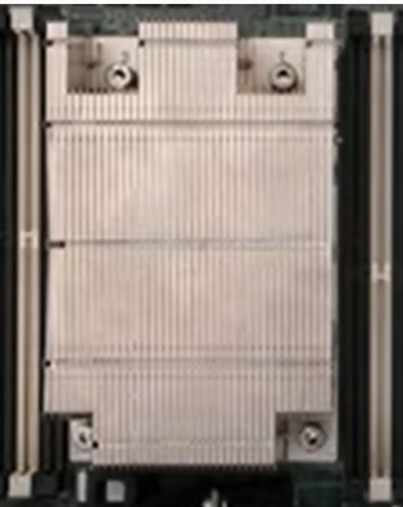
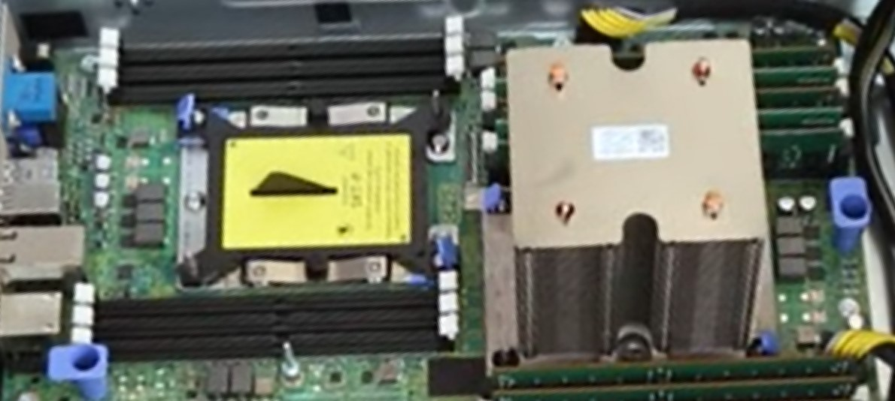
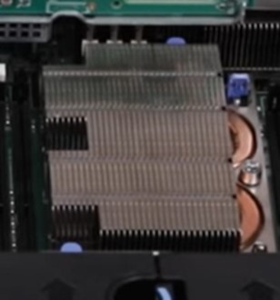
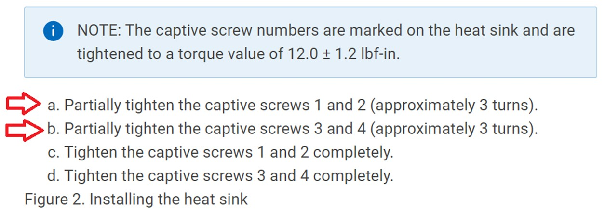
Example (Dell):
Power Edge T440, R740XD2 (Purley)
& R7525 (EPYC SP3)
EPYC
https://www.youtube.com/watch?v=wIx2GSRjIIE
Partially nuts tightened and diagonal sequence.
No label on heatsink for nuts sequence for Purley, probably due to the bolster design only required to tighten 2 nuts ?
https://www.youtube.com/watch?v=a7spFUjNTek
https://www.dell.com/support/kbdoc/en-sg/000063913/dell-emc-poweredge-t440-how-to-remove-and-install-a-system-board-qrl-video
Notes:
https://cdn.cnetcontent.com/a1/49/a149014d-d35a-444f-8752-2dc0898e107f.pdf

Slide 14
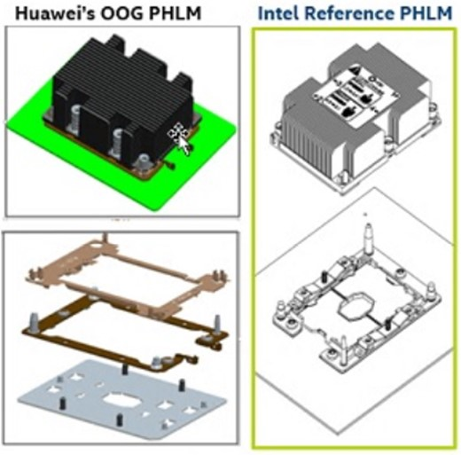
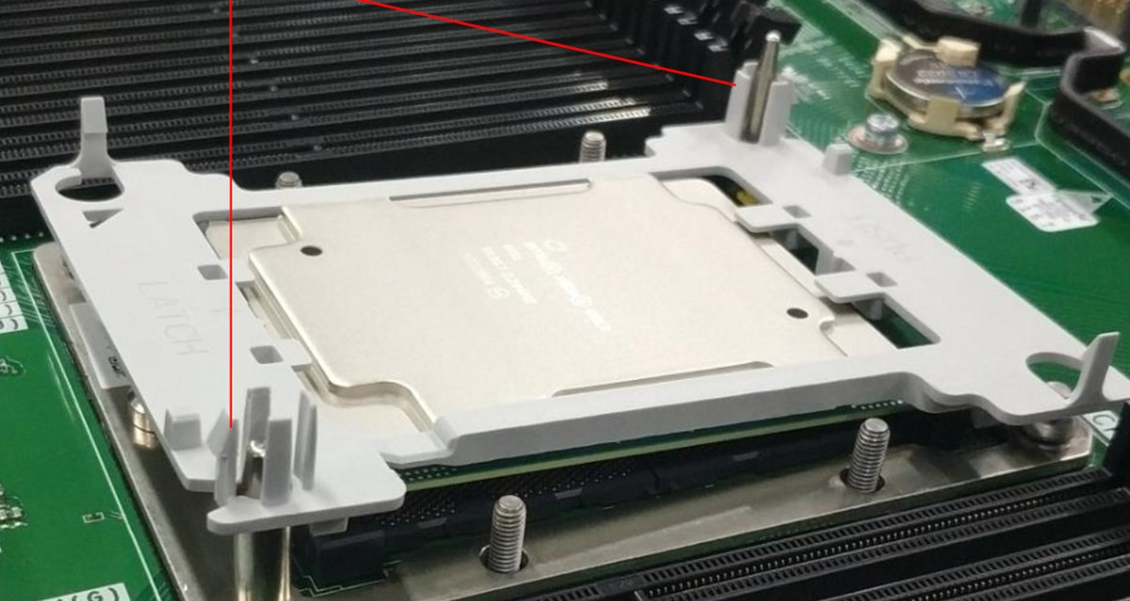
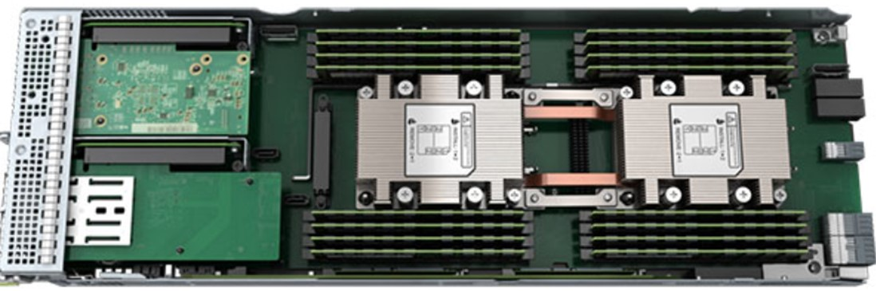
Example: Huawei XH321 V5
(Purley)
Phillips screw driver to tighten all 4 + 2 screws
Will similar concept works in Whitley/EGS ?
1
Customer claimed their PHLM is giving 30% in cost saving
2
Notes:
https://support.huawei.com/enterprise/en/doc/EDOC1000171910/bdd76eef/installing-a-processor
https://support.huawei.com/enterprise/en/doc/EDOC1000183891/a4cc5fae/installing-a-processor

Slide 15
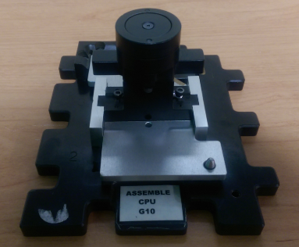
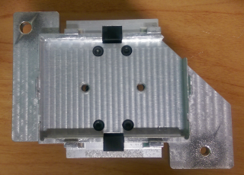
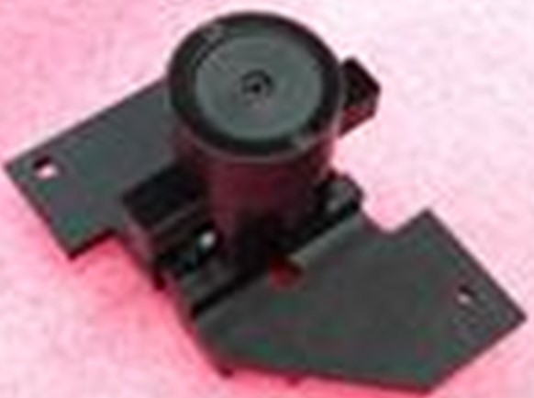
HPE/Inventec CPU PnP Tool (Purely)

Slide 16
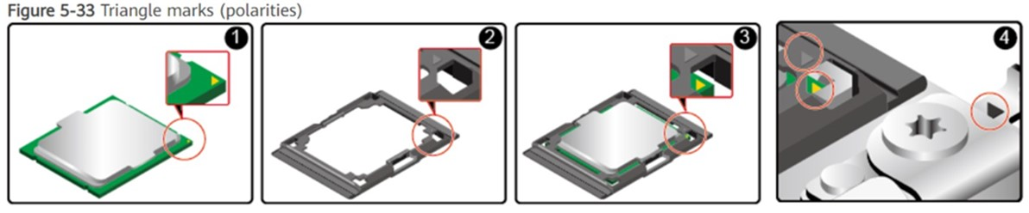
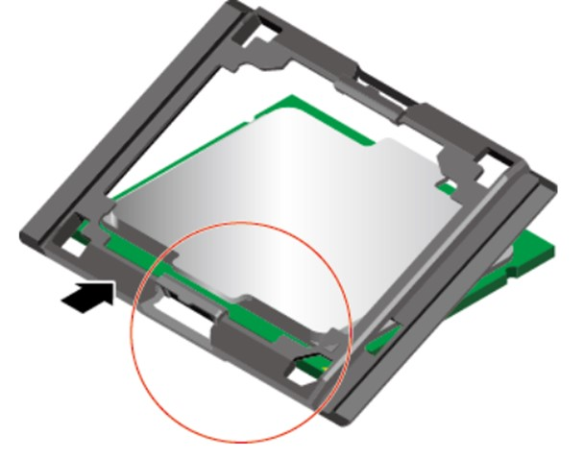
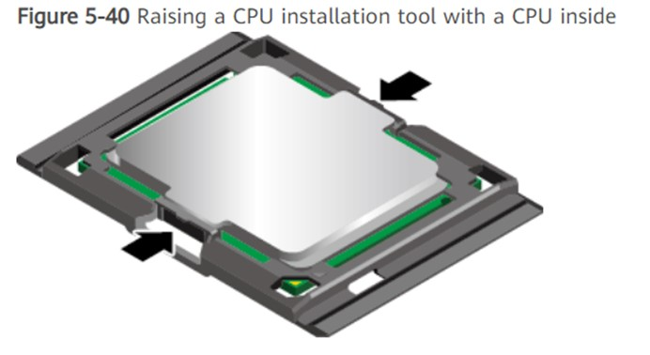
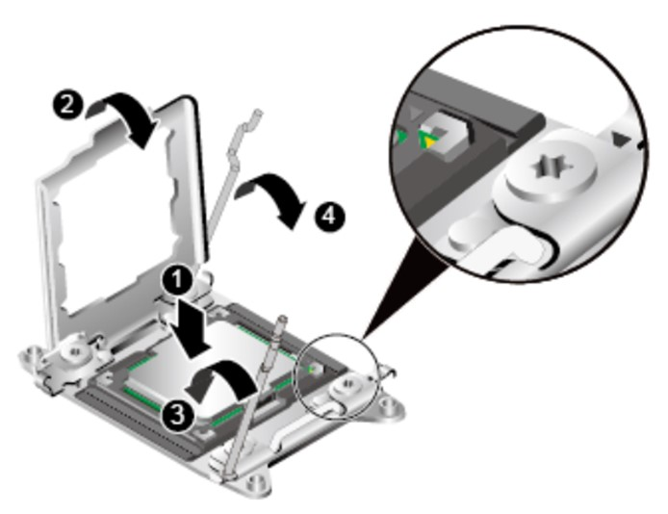
ILM Concept, carrier for CPU handling
Carrier installation at the short edges
Gripping from both short edges
Notes:
https://support.huawei.com/enterprise/en/doc/EDOC1000078548/89014b24/installing-a-cpu

Slide 17
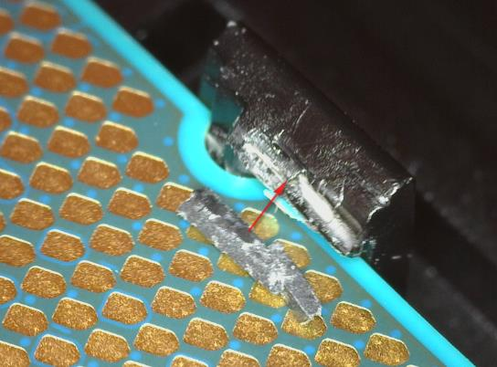
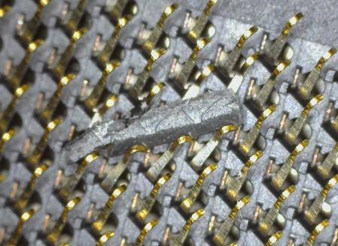
Suspected carrier damaged during assembly resulting bend contacts during automation (different boundary condition)

Slide 18
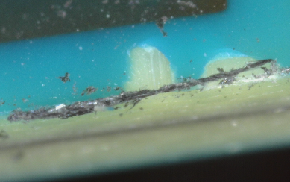
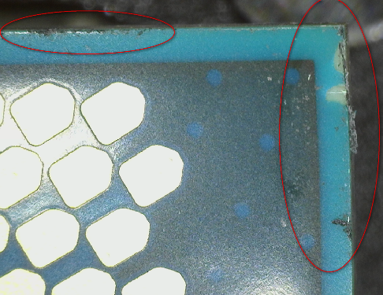
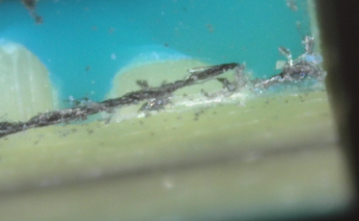
Observed debris at package edges/corners

